Slide 1


Luna Agora Data Analytics Cohort 12 Nashville Software School

Slide 2

Public Access in Nashville

Slide 3
Summary & Motivation
Summary
I want to explore what publicly accessible resources are available.
This will be accomplished by analyzing how those recourses are dispersed by zip code in relation that areas economics.
Motivation
I believe that we should have our human needs met automatically, but as a society we fall short sometimes. My main motivation is surviving in the city as an unhoused person. I wanted to see how accessible those resources are to survive and get out of a difficult situation

Slide 4
Defining Public Access
Water
Social Services (food)
Wi-fi
Libraries
Public Health Clinics
Prescription Disposal Locations
Fire Departments
Police Departments
These are some of the relevant metrics I was able to find data on.

Slide 5
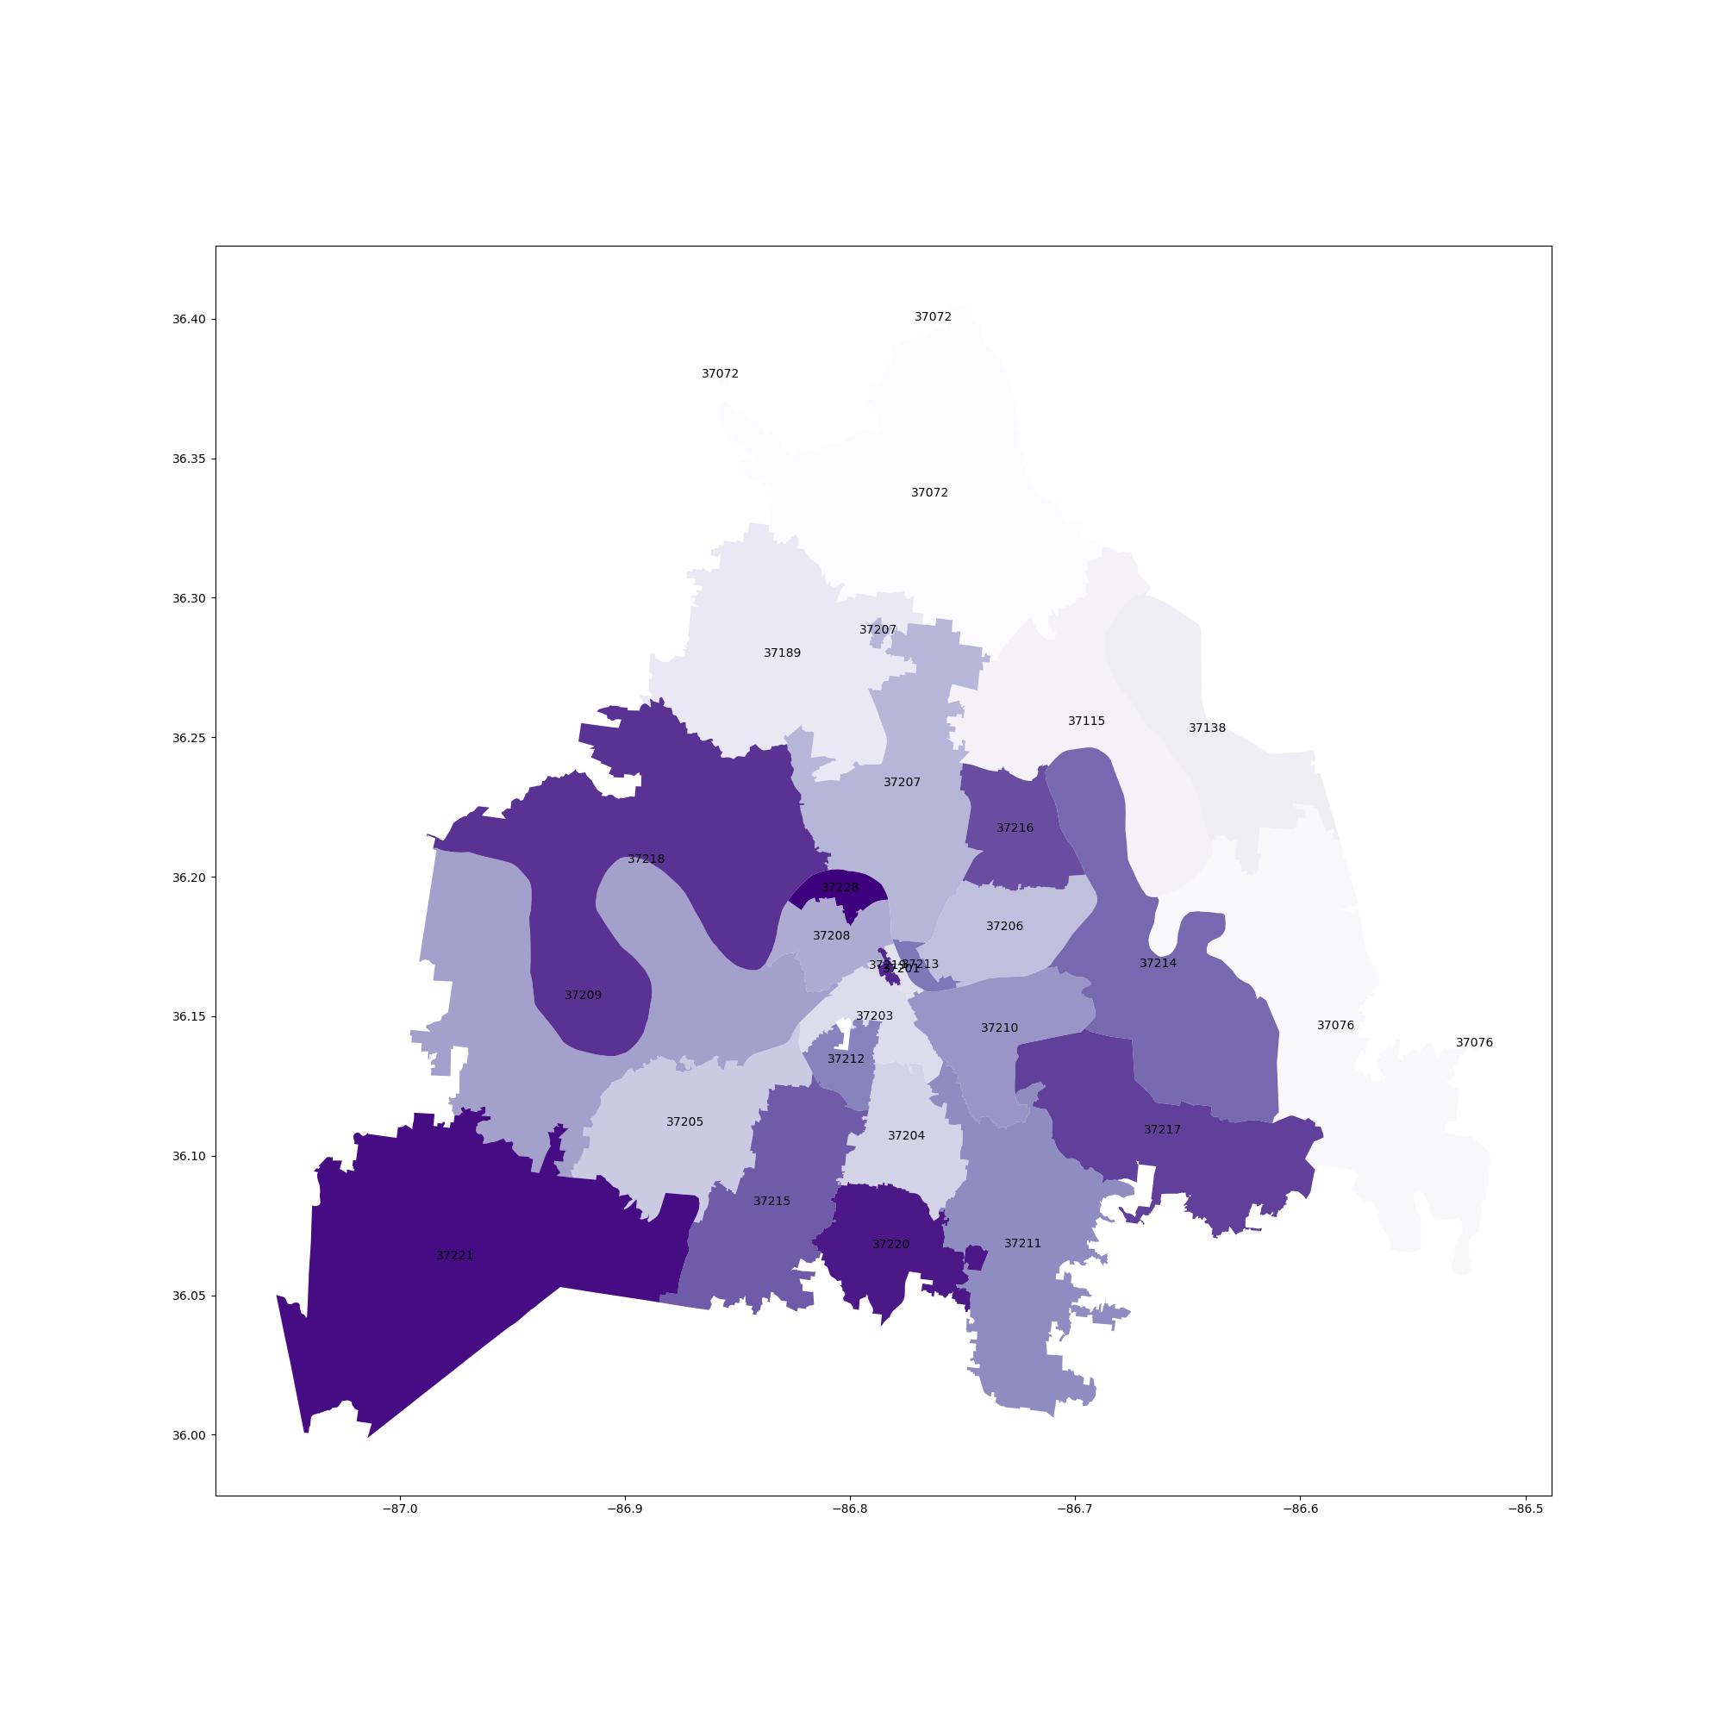
Zip-codes observed
37072
37076
37115
37138
37189
37201
37203
37204
37205
37206
37207
37208
37209
37210
37211
37212
37213
37214
37215
37216
37217
37218
37219
37220
37221
37218

Slide 6
Making an area score
The area score is based on what resources are available in each zip code.
+5 points are given for containing the resource
+0 points if zip code does not
Due to time constraints the area score is in this rudimentary stage, it only states that the area has access.
Future Plans: will make a new scoring system, that gives points with diminishing returns for multiples, for more relevant analysis

Slide 7

How does population correlate to access to public resources in Nashville?
At 59693, 37211 had the highest Population and was 271,231.82% higher than 37213, which had the lowest Population at 22.
Population and area score are positively correlated with each other.

Slide 8
How does income correlate to access to public resources in Nashville?
At 230199, 37220 had the highest average household income and accounted for 7.84% of average income.
Average household income and Area score have a negative correlation

Slide 9
How does unemployment correlate to access to public resources in Nashville?
Unemployed and area score are positively correlated with each other.
37211 accounted for 14.75% of Unemployed.

Slide 10
What area has the most access? What area has the least?
Most access
Least access

Slide 11
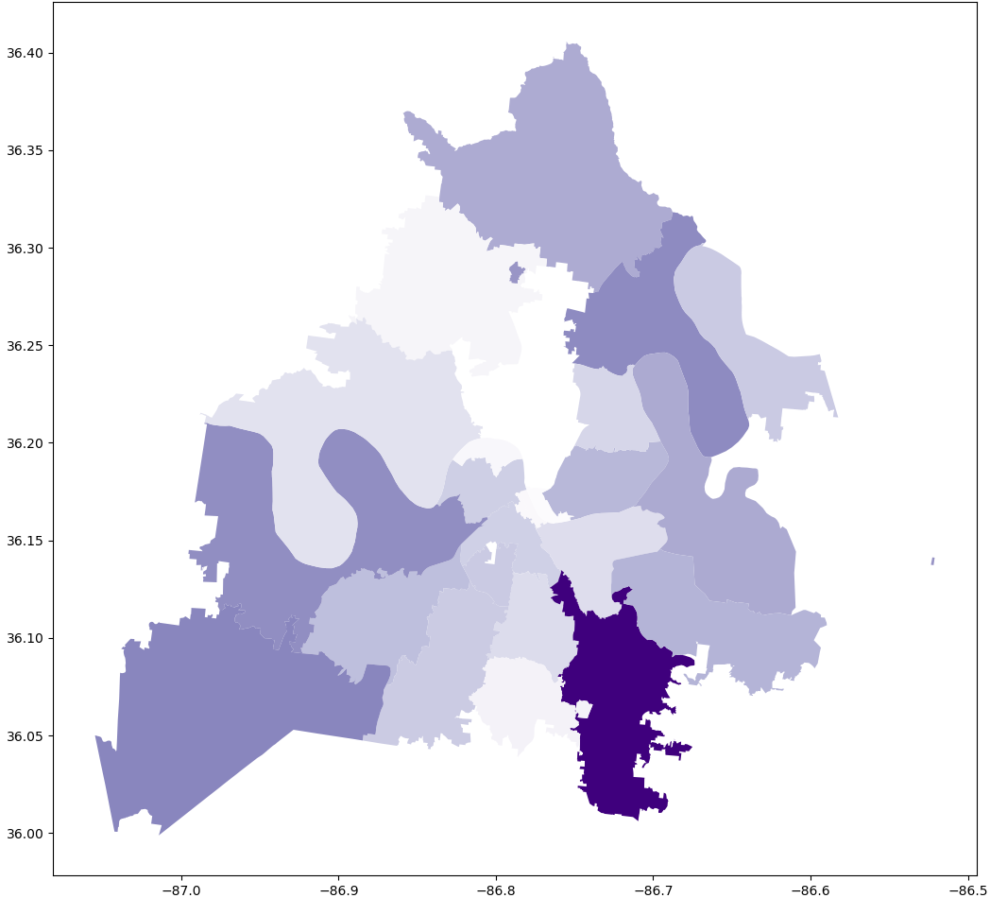
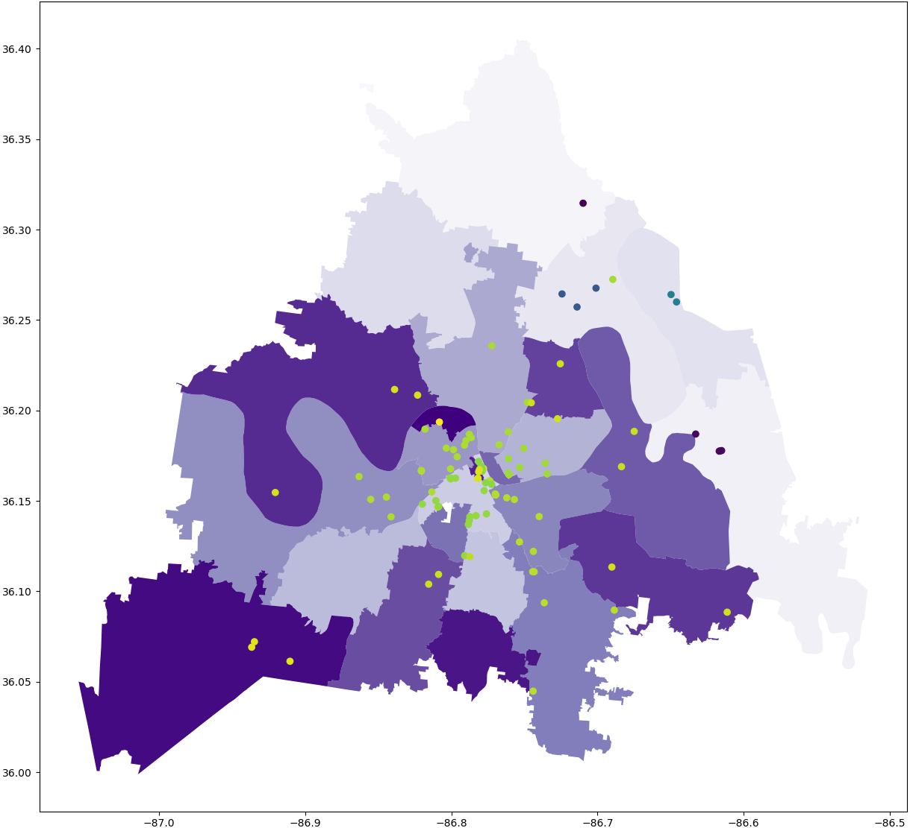
Does public wi-fi access directly correlate with population?
The correlation coefficient between population and wi-fi count by
zip-code is
-0.113188

Slide 12
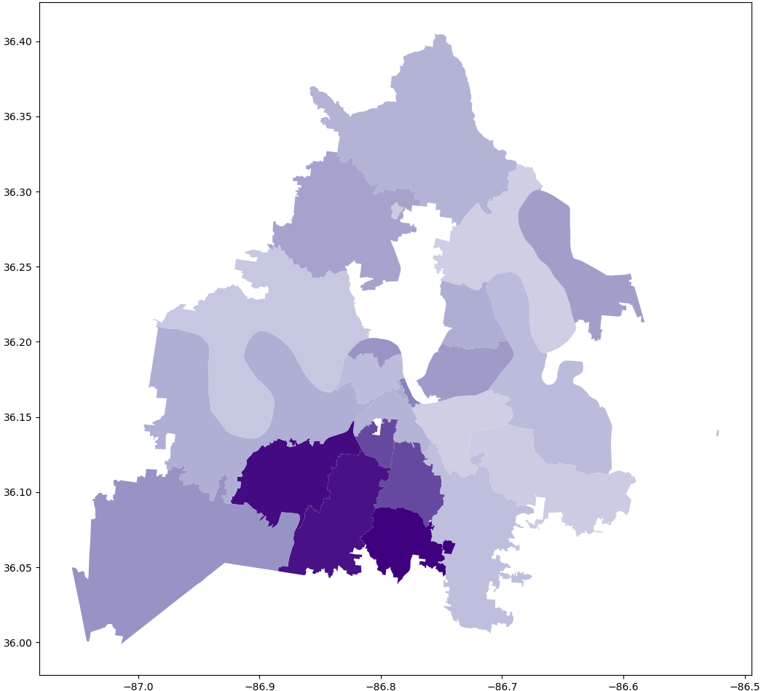
Does public wi-fi access directly correlate with unemployment?
The correlation coefficient between unemployment and wi-fi count by zip-code is
-0.061318

Slide 13
Interactive Resource Map (w.i.p.)

Slide 14
Future goals ~ re-analyze based on neighborhoods ~ add other economic correlations ~re-structure the area score
Data Sources: https:// data.census.gov (American Community Survey 2022)
https://data.nashville.gov

